Slide 1
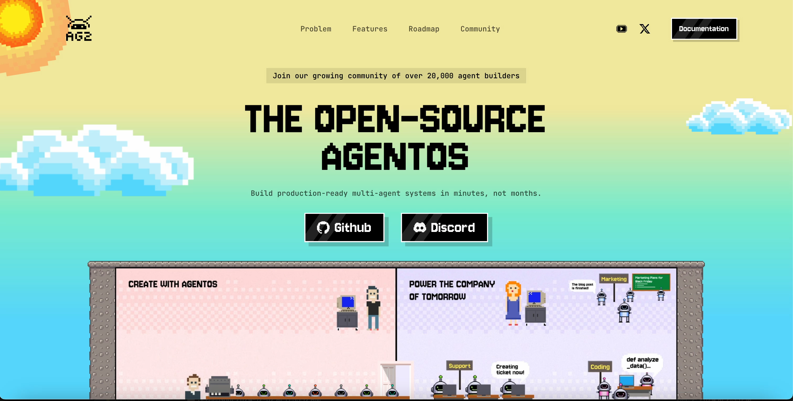

Slide 2
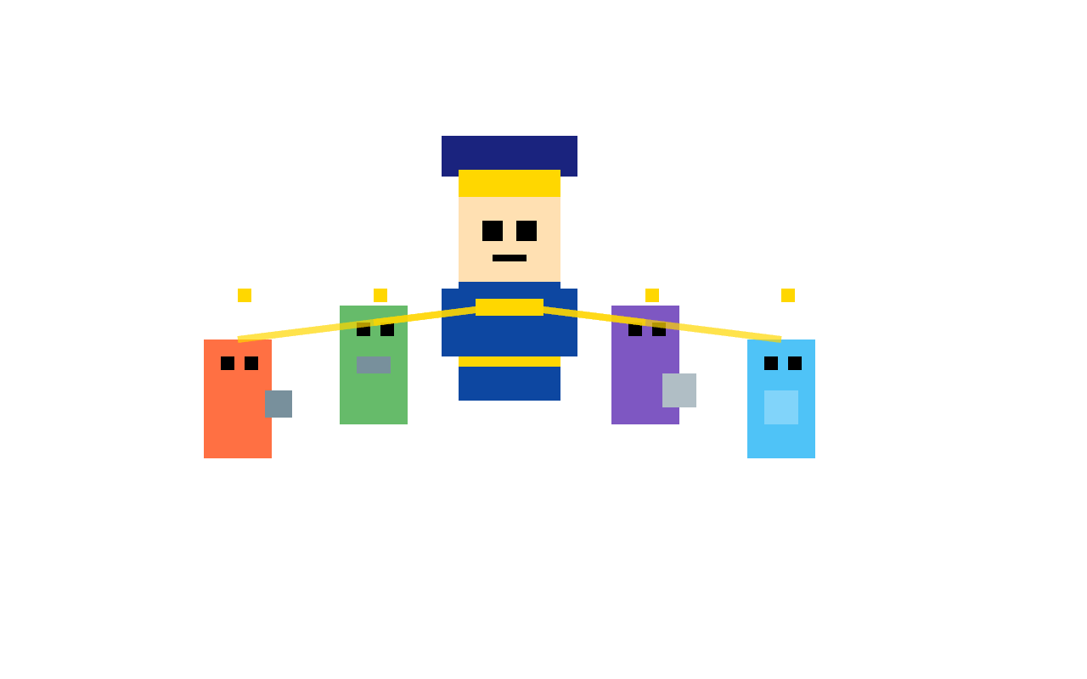
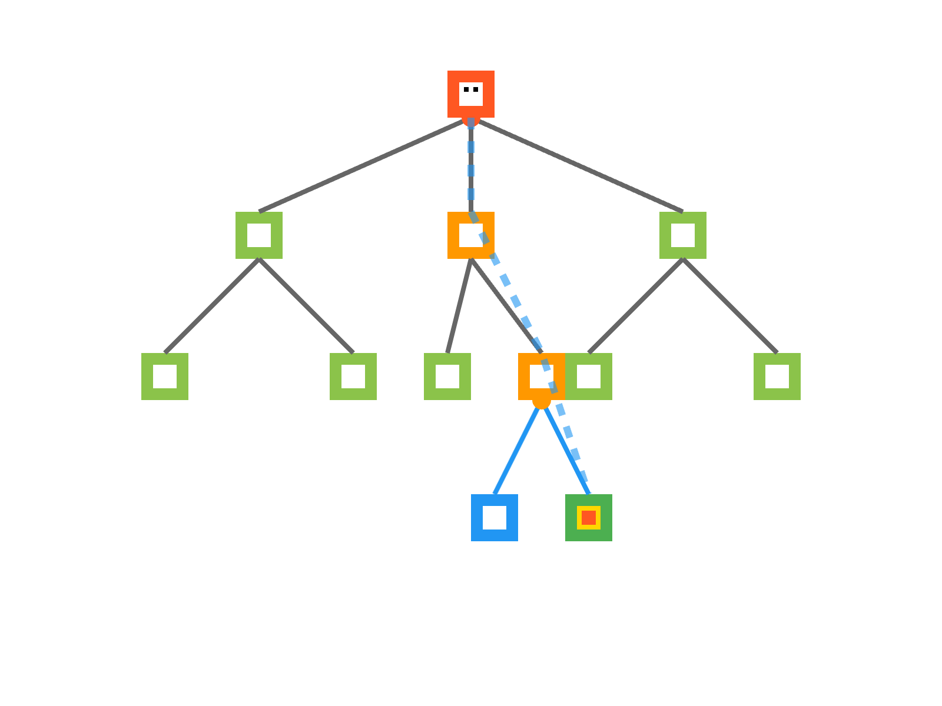

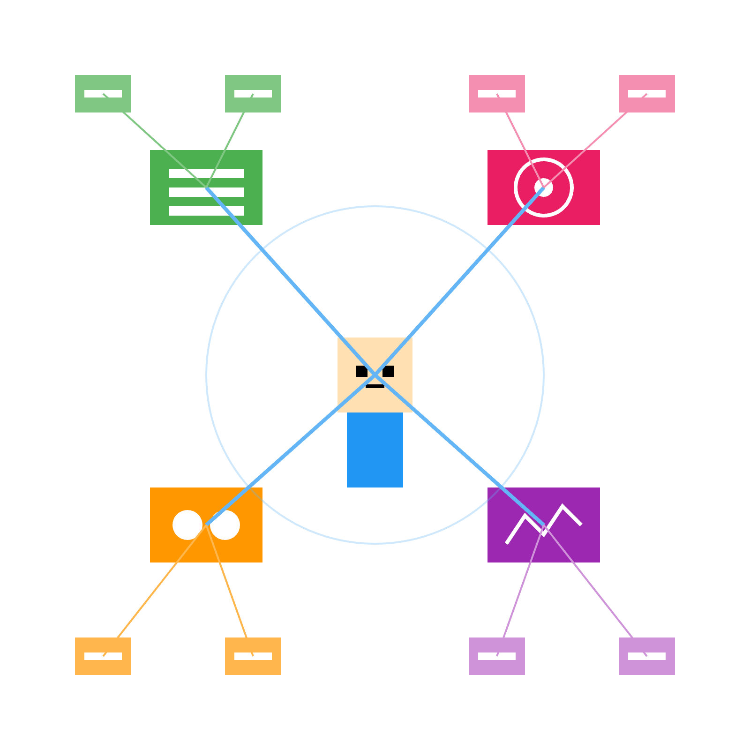

CaptainAgent
ReasoningAgent
Swarm Orchestration
Knowledgeable Agent

Slide 3
Adaptive Team Building with CaptainAgent

Slide 4
Swarm Orchestration

Slide 5
Knowledgeable Agents

Slide 6
ReasoningAgent

Slide 7



Tools

Slide 8
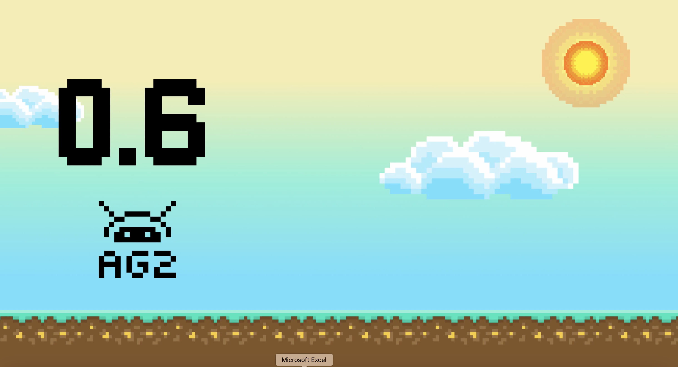

Slide 9

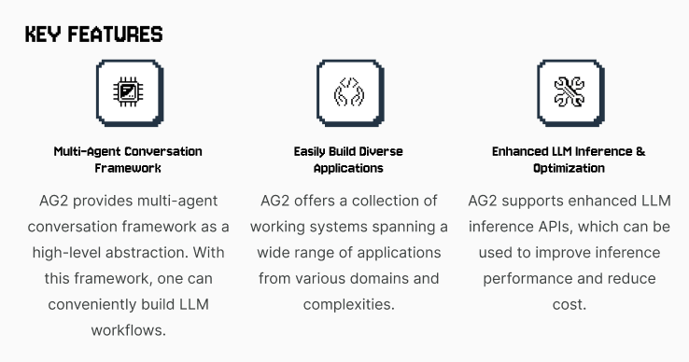
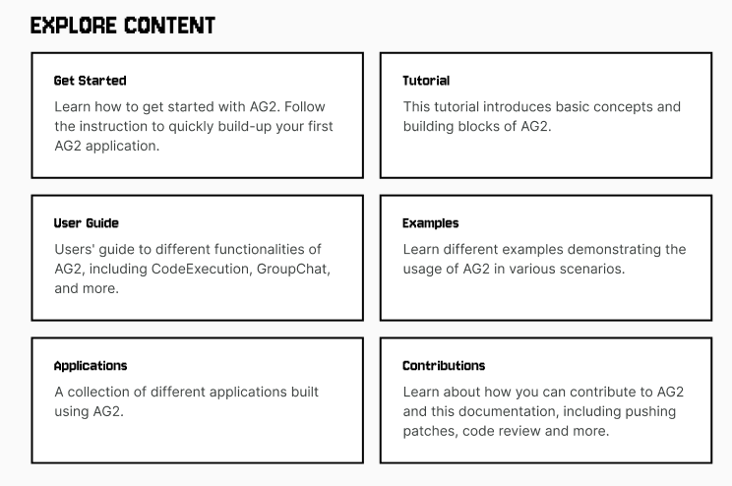
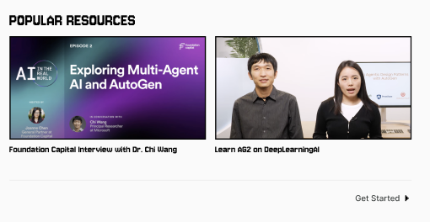

Slide 10
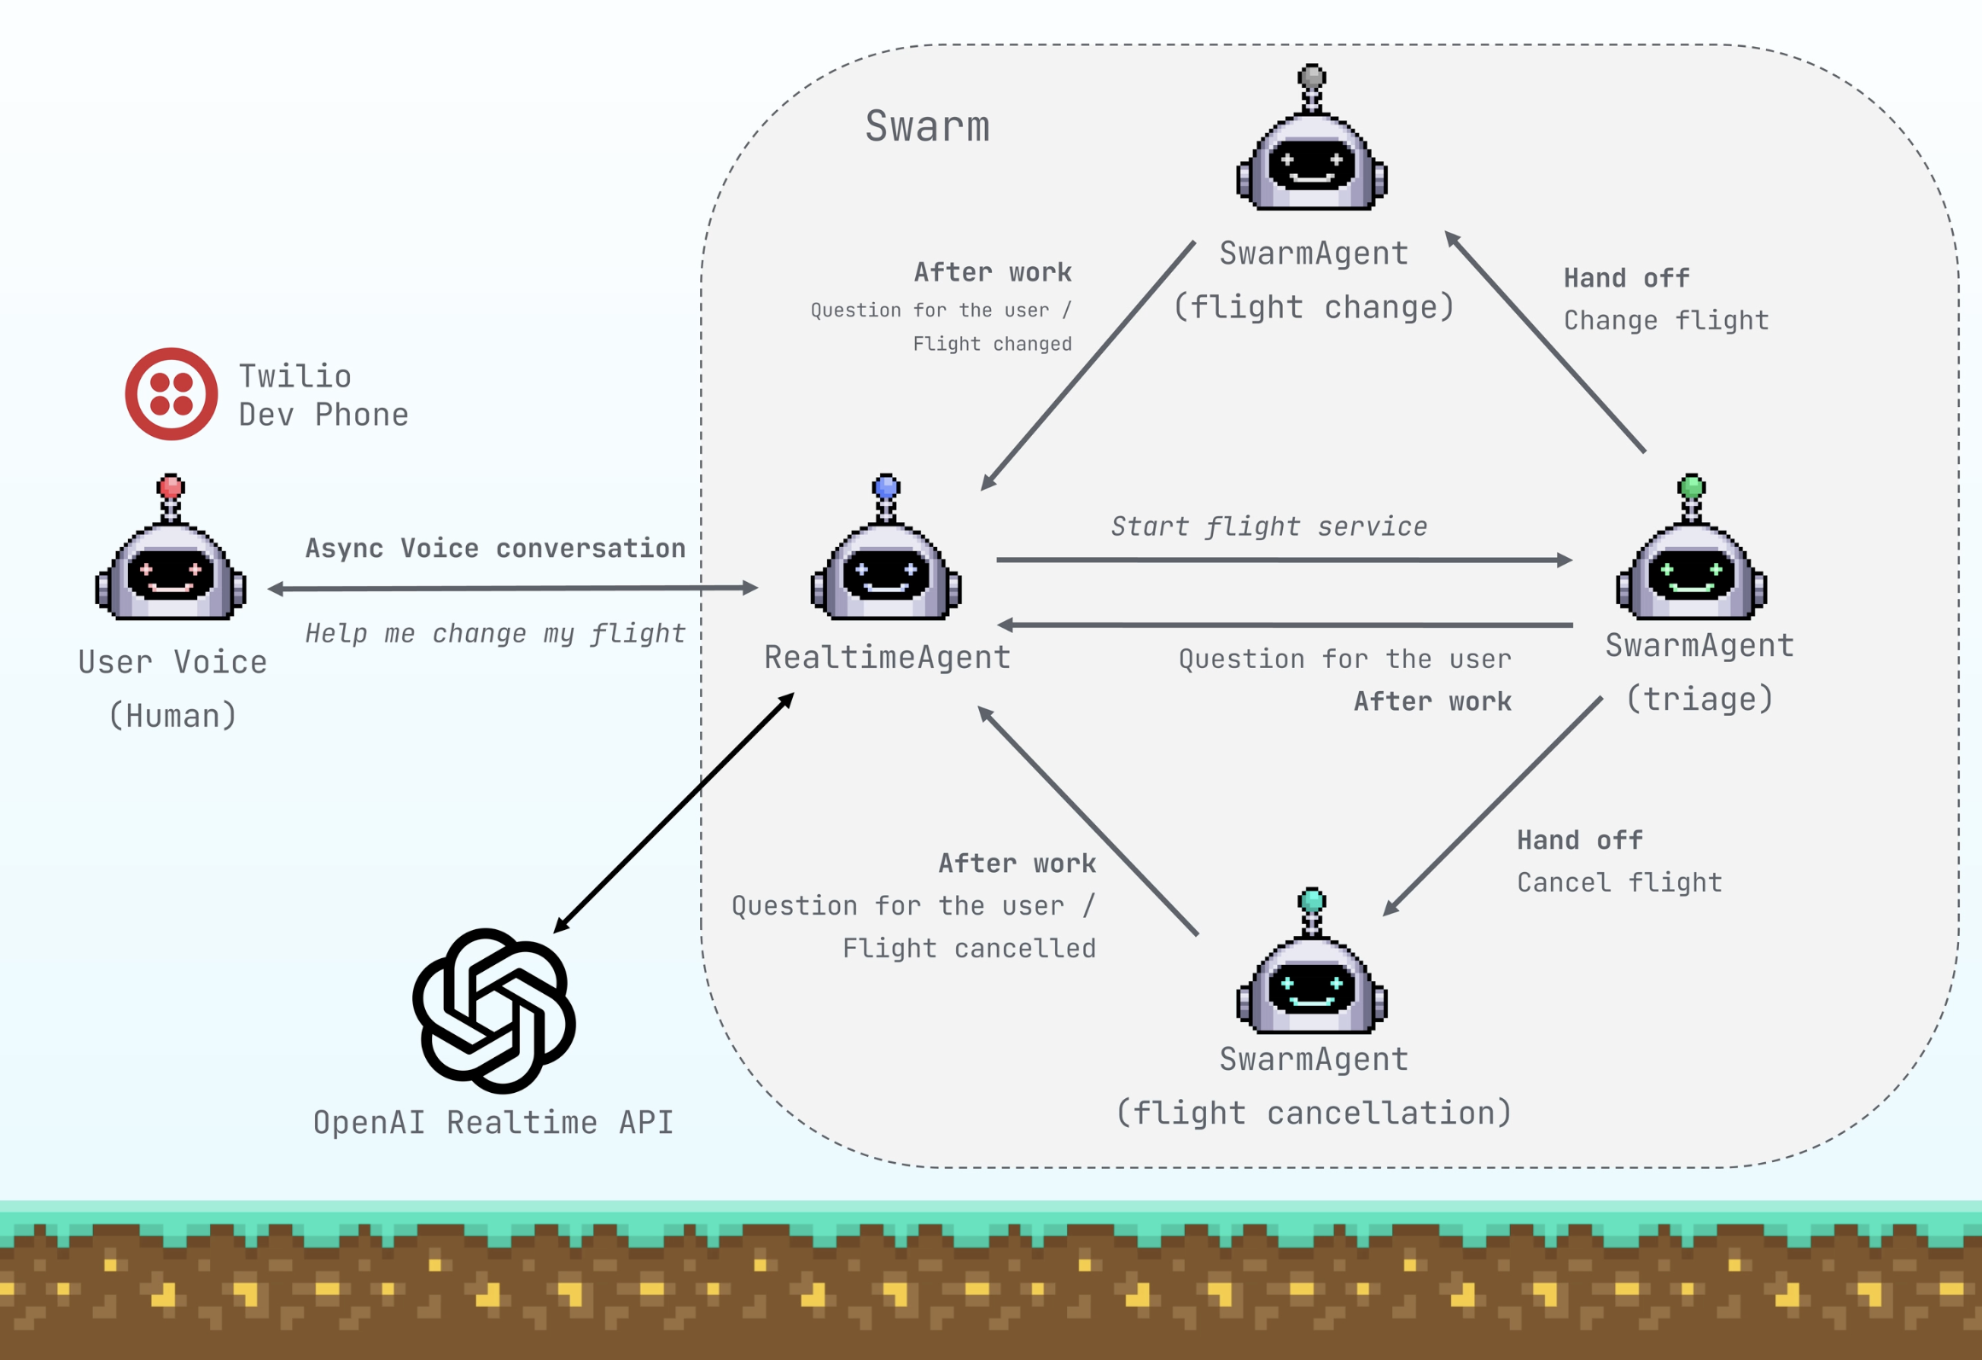

Slide 11

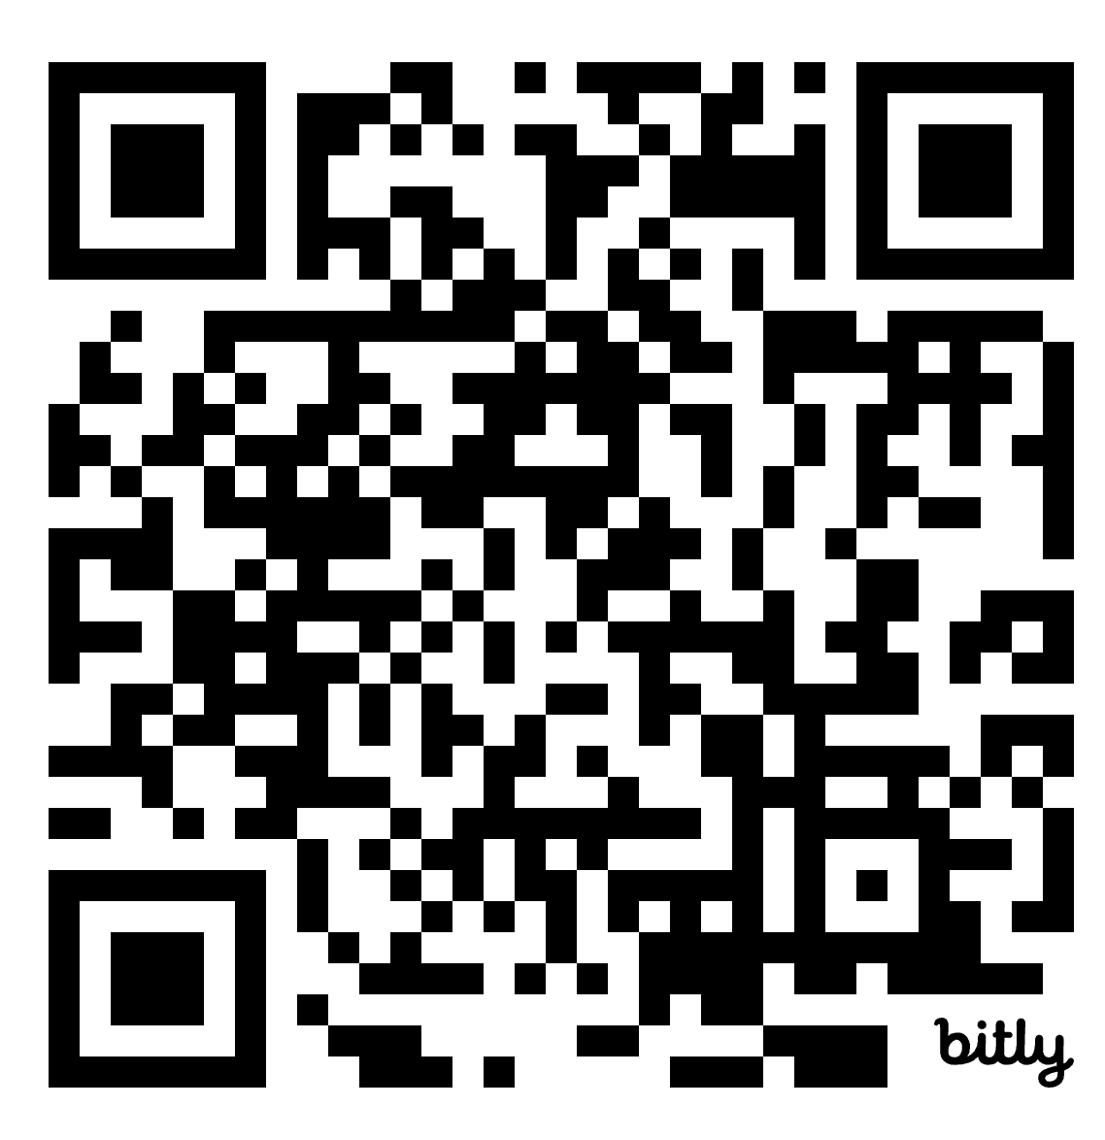
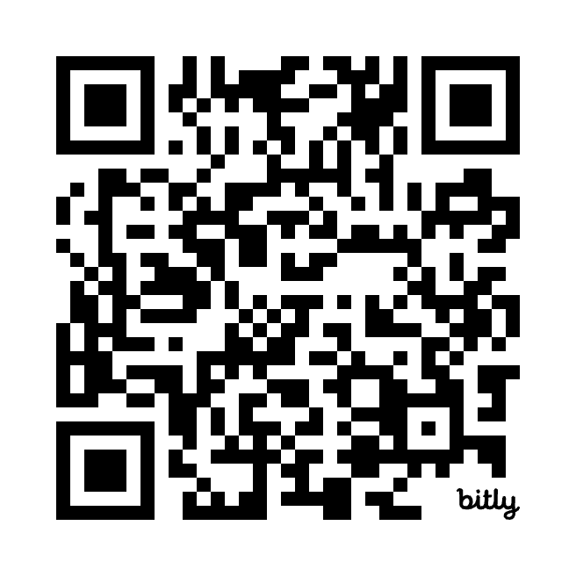
GitHub ⭐
Join our growing community of over 20,000 agent builders
Discord 👯‍♀️

